Slide 1
ML-models for Prediction of Railing Dead Load Effects Fall 2023
Team Members and Contributions
Sai Asrith Pyla (MLP, PySR Analysis)
Bhushan Raj (Data generation, PySR Conceptualization)
Deep Structural Minds
04 December 2023
Notes:
Welcome you all for this meeting for TxDOT Project 0-7116

Slide 2
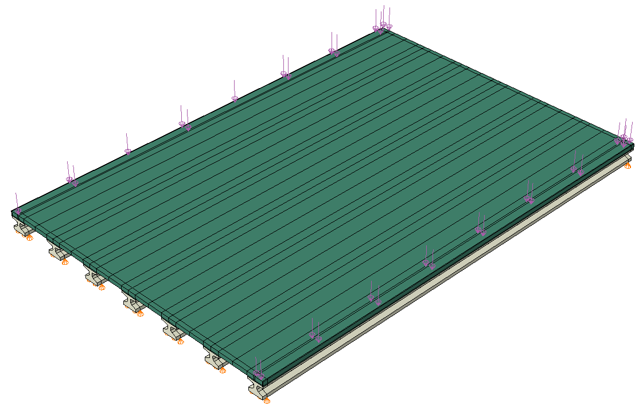
Objective
FE Analysis
Girder-Slab Bridge
Develop ML models that can predict the normalized design moments and reactions for any given geometry
Bending Moment Diagram for Girders
2 of 55

Slide 3
Methodology
Multi-Layer Perceptron
MLP composed of many interconnected perceptrons can be used to build neural networks with substantial representational power
Three hidden layers with 32 neurons each and ReLU activation functions
MSE based loss function is considered in the analysis
Adam optimizer is used
Symbolic Regression (PySR)
PySR is a multi-population evolutionary algorithm for Symbolic Regression
Developed on Julia
Evolve-Simplify-Optimize Loop
Selects the “best” equation that is also based on simplicity (Occam’s Razor)
Scoring of equations based on loss and complexity

Slide 4
Interesting Information
Multi-Layer Perceptron
Inputs:
Span Length L
Overhang width w_{ho}
Girder spacing S
Thickness of deck slab t_{s}
Girder depth D
Outputs: (Total: 8)
Maximum bending moments and bearing reactions in all girders
Testing loss = 0.00046
Training loss = 0.00043
Drawback: knowledge is hidden and not human-interpretable
Symbolic Regression (PySR)
Operators chose based on the data
Relation between output and input were observed to make a scientific estimation of the possible operators
populations=50
niterations=40
binary_operators=['+', '-', '*', '/', '^', "physics(x, y) = x^2 / y"]
unary_operators=["square", "cube", "sqrt", "inv(x) = 1/x"]
loss= (prediction - target)^2
Outputs: Symbolic model for bending moment and reaction in exterior and first interior girder
Good Fit

Slide 5
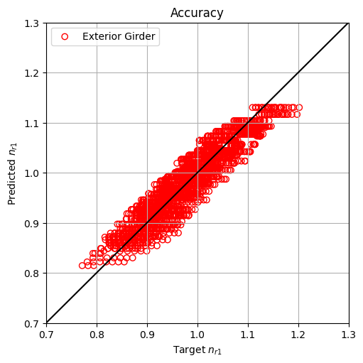
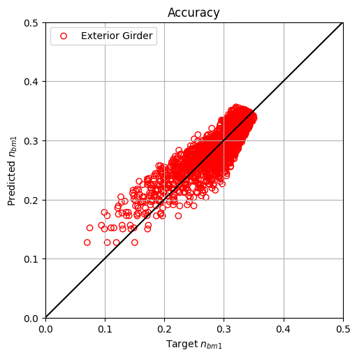
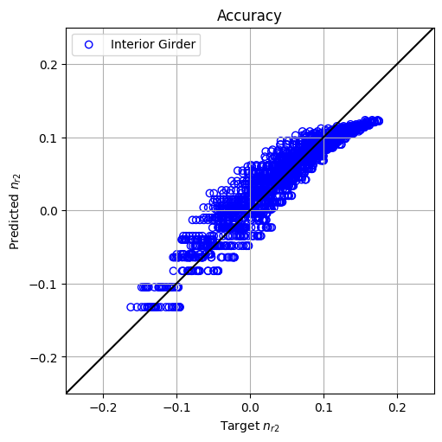
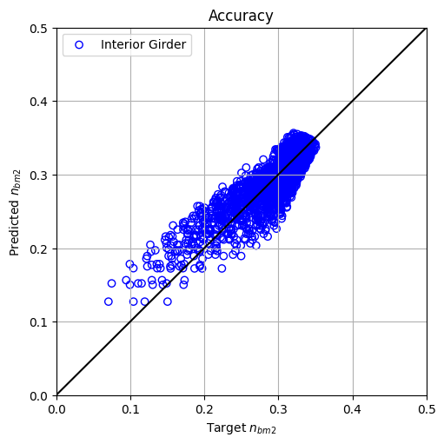
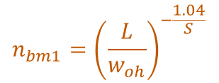
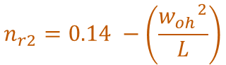
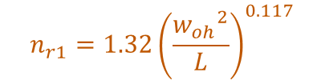
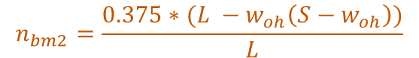
Results
$$n_{bm1}={\left(\frac{L}{w_{oh}}\right)}^{−\frac{1.04}{S}}$$
Loss = 0.0043
$$n_{r1}=1.32{\left(\frac{{w_{oh}}^{2}}{L}\right)}^{0.117}$$
Loss = 0.0005
$$n_{bm2}=\frac{0.375∗(L −w_{oh}\left(S−w_{oh}\right))}{L}$$
Loss = 0.0005
$$n_{r2}=0.14 −\left(\frac{{w_{oh}}^{2}}{L}\right)$$
Loss = 0.0008

Slide 6
Results
MLP model had lower loss compared to PySR
PySR provided equations for n_{r1} and n_{r2} that were explainable based on the data
For n_{bm1}, the equation was complicated because of the exponent with dimensions and not intuitive
Accuracy of equations from PySR could be improved by considering more operators and data

